Slide 1
Microprocessors and Assembly Language Lecture 3 Hamed Farbeh farbeh@aut.ac.ir Spring 2023

Slide 2
Copyright Notice
Parts (text & figures) of this lecture are adopted from:
Atmel | SMART ARM-based MCU DATASHEET, SAM3X / SAM3A Series, Atmel-11057C-ATARM-SAM3X-SAM3A-Datasheet_23-Mar-15

Slide 3
SAM3X8E Specifications

Slide 4
Configuration Summary

Slide 5
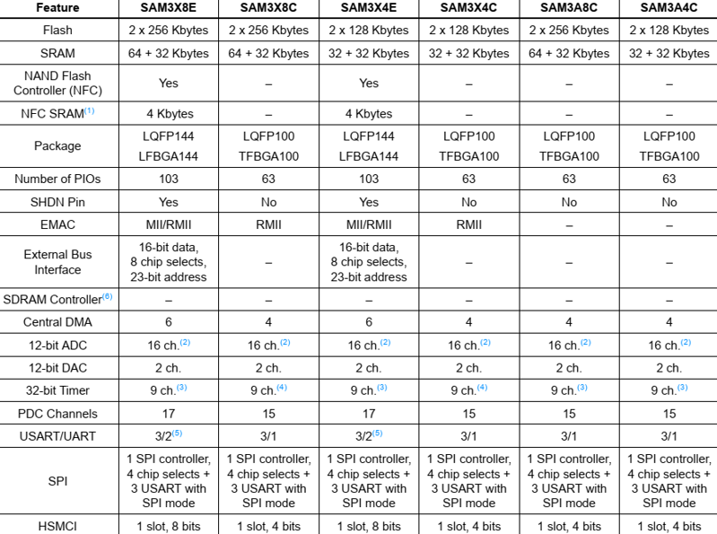

Slide 6
Recap
Harvard architecture
Memory to store data
SRAM, volatile
Memory to store instructions
FLASH, non- volatile

Slide 7
SAM3X8E Operating Modes
Active Mode
Normal running mode with the core clock running from the fast RC oscillator
Low Power Modes
Embedded systems are reactive
Backup Mode
Wait Mode
Sleep Mode

Slide 8
SAM3X8E Operating Modes
Low Power Modes
Backup Mode
Achieve the lowest power consumption possible in a system
For tasks not requiring fast startup time (< 0.5 ms)
The core is off
Note that peripherals responsible for detecting and handling interrupts are not off
Wait Mode
Very low power while maintaining the whole device in a powered state for a startup time of less than 10 µs
The clocks of the core, peripherals and memories are stopped
The core, peripherals, and memories power supplies are still powered
Sleep Mode
Only the core clock is stopped
Example: Direct Memory Access (DMA)

Slide 9
SAM3X8E Input/Output Lines
General Purpose I/O Lines (GPIO)
Managed by Parallel Input/Output (PIO) Controllers
I/O Modes:
Pull-up
Input Schmitt triggers
Multi-drive (open-drain)
Glitch filters
Debouncing
Input change interrupt

Slide 10

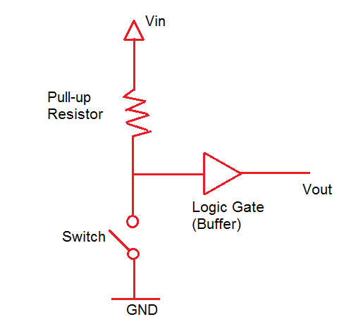

I/O Modes
Pull-up
output lines are usually pull-up
example: telephone lines

Slide 11
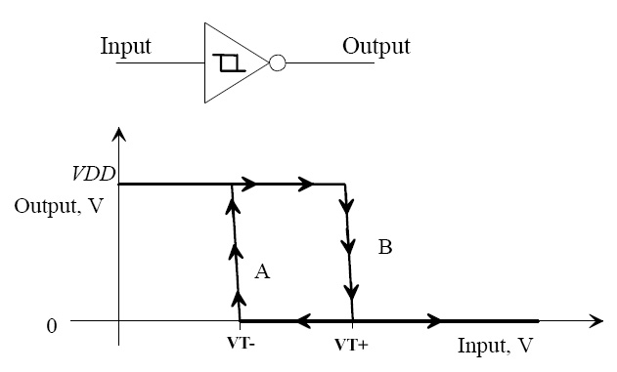
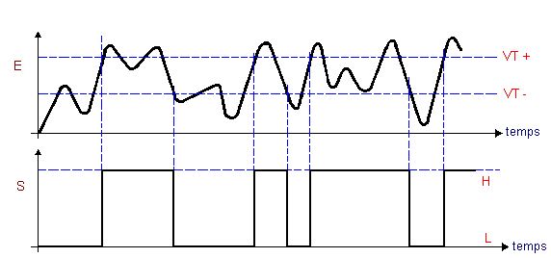
I/O Modes
Input Schmitt triggers
usually used for input lines
example: water heater

Slide 12
I/O Modes
Multi-drive (open-drain)
both input and output lines can be open-drain

Slide 13
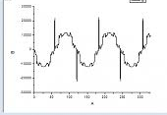
I/O Modes
Glitch filters

Slide 14
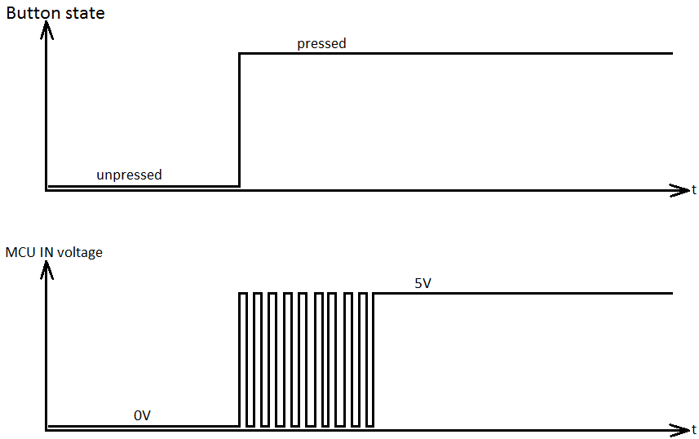

I/O Modes
Debouncing

Slide 15
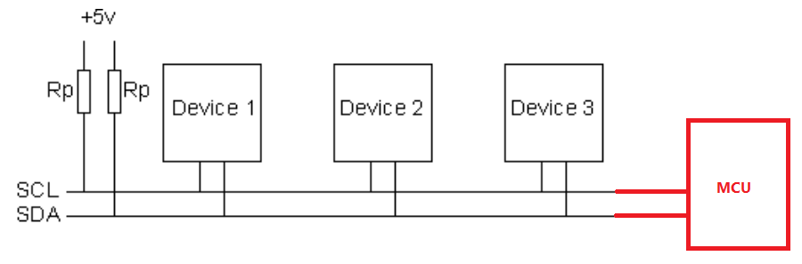
I/O Modes
Input change interrupt

Slide 16
SAM3X8E Input/Output Lines
System I/O Lines
Shared with PIO lines
NRST Pin
Handled by the on-chip reset controller (bidirectional)
Provides a reset signal to the external components
Is asserted low externally to reset the microcontroller
NRSTB Pin
Asynchronous reset of the SAM3X/A series when asserted low
ERASE Pin
Reinitialize the Flash content to an erased state

Slide 17
SAM3X8E External Memories
External Memory Bus
Integrates Four External Memory Controllers
Static Memory Controller
NAND Flash Controller
SLC NAND Flash ECC Controller
Single Data Rate Synchronous Dynamic Random Access Memory (SDR-SDRAM)
Up to 24-bit Address Bus (up to 16 Mbytes linear per chip select)
Up to 8 chip selects, Configurable Assignment

Slide 18
Real-time Timer (RTT)
A 32-bit counter
For counting elapsed seconds
Generates a periodic interrupt and/or triggers an alarm
Real-time Timer Value Register
Name: RTT_VR
Address: 0x400E1A38
Access: Read-only

Slide 19

Real-time Clock (RTC)
RTC peripheral is designed for very low power consumption
Combines a complete time-of-day clock with alarm and a 200-year Gregorian calendar
Programmable periodic interrupt

Slide 20
Watchdog Timer (WDT)
Used to prevent system lock-up
If the software becomes trapped in a deadlock
Is loaded with an initial value greater than the worst case time delay
If not reinitialized before reaching 0
An interrupt is generated to reset the processor
A 12-bit down counter
Watchdog period of up to 16 seconds

Slide 21
The End!

